Slide 1
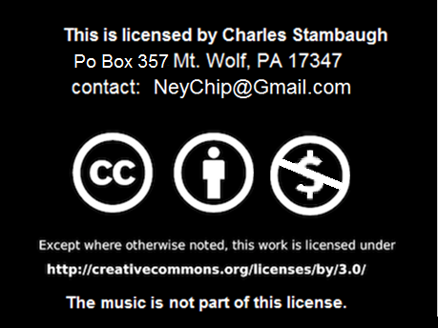
Click to start.

Slide 2
Click to play!
The Bible
Game 2

Slide 3
INSTRUCTIONS
Need host, three players and score keeper.
Click on requested category number box for question.
Wait for person to give answer or they all give up, then click on that question page for answer. You can use the sound effects.
Answers do not have to be exact nor in question form.
To promote guessing, do not remove points for wrong answers except for the Final Jeopardy question located at bottom right.
Click on the house to go to main game screen.
This is a free educational presentation which is not associated with the TV game show.

Slide 4
The Bible
Numbers
Jesus
Verses
Who
Old T.
10
10
10
10
10
20
20
20
20
20
30
30
30
30
30
40
40
40
40
40
50
50
50
50
50
Rev: 01/17/14
Final Question

Slide 6
Numbers 10 How many books of the Bible are named after woman?
Two
Click here for the answer.

Slide 8
Numbers 20 How many Days did God cause it to rain with the great flood?
40 days
Click here for the answer.

Slide 10
Numbers 30 How many years will the antichrist reign?
Seven years
Click here for the answer.

Slide 12
Numbers 40 How many years were the children of Israel in the wilderness?
40 years
Click here for the answer.

Slide 14
Numbers 50 from a boy’s lunch, how many loaves & fishes did Jesus feed over 5,000 with?
5 loaves & 2 fishes
Click here for the answer.

Slide 16
Jesus 10 Who baptized Jesus?
John the Baptist
Click here for the answer.

Slide 18
Jesus 20 How many times did peter deny Christ?
three
Click here for the answer.

Slide 20
Jesus 30 What did Jesus use to answer Satan with during his temptations?
God's written Word
Click here for the answer.

Slide 22
Jesus 40 Jesus said to Peter and Andrew, I will make you ____ of men.
fishers
Click here for the answer.

Slide 24
Jesus 50 Who did Saul see on his way to persecute Christians?
Jesus
Click here for the answer.

Slide 26
Verses 10 Genesis 1:1 In the beginning God Created …..
The heavens and the earth.
Click here for the answer.

Slide 28
Verses 20 Phil 4:13 . I can do all things through _____ that strengthen me.
Christ
Click here for the answer.

Slide 30
Verses 30 Acts 16:31 . Believe on the Lord Jesus and you shall be?
Saved
Click here for the answer.

Slide 32
Verses 40 I John 1:9 . If we confess our sins, he is faithful and just to ____ us our sins.
forgive
Click here for the answer.

Slide 34
Verses 50 Hebrews 4:12 . for the word of the god is quick and powerful and sharper that any…
Two edged sword
Click here for the answer.

Slide 36
Who 10 Who did God talk to though a burning bush?
Moses
Click here for the answer.

Slide 38
Who 20 Who was swallowed by a large whale?
Jonah
Click here for the answer.

Slide 40
Who 30 Who did Jesus call the rock that his church will be build on?
Peter
Click here for the answer.

Slide 42
Who 40 Who’s strength was in his hair?
Samson
Click here for the answer.

Slide 44
Who 50 Who was the tax collector that climb a tree to see Jesus?
Zacchaeus
Click here for the answer.

Slide 46
Old Testament 10 God formed man from what?
The dust of the ground.
Click here for the answer.

Slide 48
Old Testament 20 . Belshazzar the king saw what on the wall that TOLD HIS FATE?
Hand writing
Click here for the answer.

Slide 50
Old Testament 30 Who lead the battle of Jericho?
Joshua
Click here for the answer.

Slide 52
Old Testament 40 What is the name of the last book of the old testament?
Malachi
Click here for the answer.

Slide 54
Old Testament 50 . Who lost his farm, family, wealth and health in one day, but did not curse god?
JOB
Click here for the answer.

Slide 56
Final Jeopardy
I AM
Record how much you want to wager. Remember, if wrong that amount will be deducted from your score.
When ready the question is..

Slide 57
Final Jeopardy According to John 14:6, Jesus said “I am the ___, the ____, and the ____”
way, truth, life
Click here for the answer.
Click here
to end.

Slide 58
By Charles Stambaugh
Thank you for playing
The Bible

