Slide 1
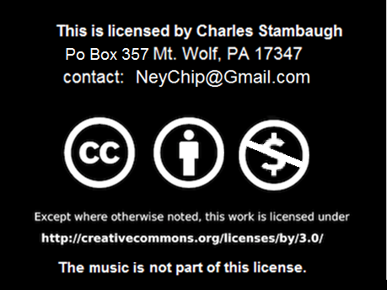
Click to start.

Slide 2
Click to play!
The Bible
Game 1

Slide 3
INSTRUCTIONS
Need host, three players and score keeper.
Click on requested category number box for question.
Wait for person to give answer or they all give up, then click on that question page for answer. You can use the sound effects.
Answers do not have to be exact nor in question form.
To promote guessing, do not remove points for wrong answers except for the Final Jeopardy question located at bottom right.
Click on the house to go to main game screen.
This is a free educational presentation which is not associated with the TV game show.

Slide 4
The Bible
Numbers
Jesus
Verses
Who
Old T.
10
10
10
10
10
20
20
20
20
20
30
30
30
30
30
40
40
40
40
40
50
50
50
50
50
Rev: 01/19/14
Final Question

Slide 6
Numbers 10 How many books of the Bible are there?
56
Click here for the answer.

Slide 8
Numbers 20 What day Did God create man?
The Sixth
Click here for the answer.

Slide 10
Numbers 30 How many sons did Jacob have?
12
Click here for the answer.

Slide 12
Numbers 40 . How old was the oldest man recorded in the Bible? (with in 10 years)
969 years
Click here for the answer.

Slide 14
Numbers 50 How many books of the Bible start with a number?
17
Click here for the answer.

Slide 16
Jesus 10 Who did Peter say that Jesus was?
The Christ, the Son of the Living God.
Click here for the answer.

Slide 18
Jesus 20 What did Jesus tell nicodemus that he must do?
Must be born again.
Click here for the answer.

Slide 20
Jesus 30 who did jesus raise from the dead in Bethany?
Lazarus
Click here for the answer.

Slide 22
Jesus 40 Who is the comforter that Jesus spoke of?
Holy Spirit
Click here for the answer.

Slide 24
Jesus 50 What happened the third day after his crucifixion?
He arose.
Click here for the answer.

Slide 26
Verses 10 . John 14:2 . in my father’s house there are many…..
Mansions
Click here for the answer.

Slide 28
Verses 20 . Psalm 23:1 . The Lord is my ________ I shall not want…
Shepherd
Click here for the answer.

Slide 30
Verses 30 Believe on the Lord Jesus and you shall be…
Saved
Click here for the answer.

Slide 32
Verses 40 . Psalm 119:11 . Your word have I hid in my heart so that I might not…
Sin against You.
Click here for the answer.

Slide 34
Verses 50 . Ephesians 2:8,9 . … it is the gift of God, not of _____ lest any man should boast.
Works
Click here for the answer.

Slide 36
Who 10 Who was the first woman?
Eve
Click here for the answer.

Slide 38
Who 20 Who said let my people go?
Moses
Click here for the answer.

Slide 40
Who 30 What was Paul’s name before he was converted?
Saul
Click here for the answer.

Slide 42
Who 40 Who betrayed Jesus?
Judas
Click here for the answer.

Slide 44
Who 50 Which disciple of Jesus was a tax collector and wrote a book?
Matthew
Click here for the answer.

Slide 46
Old Testament 10 . What did the ark of the covenant house and we still read today?
The ten commandments tablets.
Click here for the answer.

Slide 48
Old Testament 20 . What did god give as a sign that he will not again destroy the world with water?
Rainbow
Click here for the answer.

Slide 50
Old Testament 30 Which book is in the middle of the bible?
Psalms
Click here for the answer.

Slide 52
Old Testament 40 How many stones did it take for David to kill goliath?
One
Click here for the answer.

Slide 54
Old Testament 50 Why wasn’t Daniel eaten while in the lions’ den?
God kept the lions’ mouths shut.
Click here for the answer.

Slide 56
Final Jeopardy
Shall Not
Record how much you want to wager. Remember, if wrong that amount will be deducted from your score.
When ready the question is..

Slide 57
Final Jeopardy According to John 3:16, those who believe shall not?
Parish
Click here to end.
Click here for the answer.

Slide 58
By Charles Stambaugh
Thank you for playing
The Bible

